Slide 1
Exploratory Data Analysis Airbnb & Football players data

Slide 2
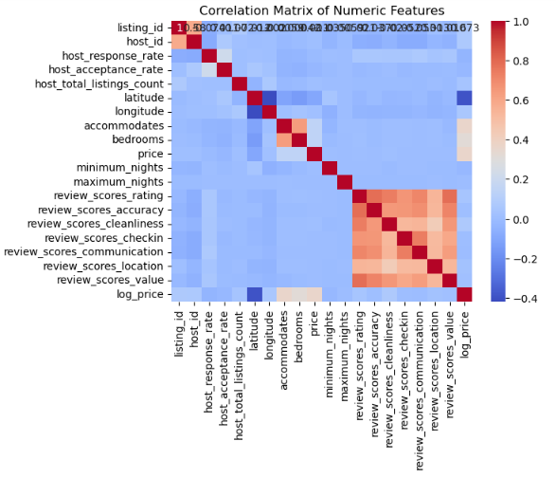
Introduction (Airbnb)
Objectives and Methodology :
Data preparation and analysis
Find patterns and correlations within dataset
Findings and conclusion
Data Cleaning and Preprocessing:
handling missing value
transforming skewed data
Identifying key features
Exploring the Listings data:
Understanding the distribution of prices
Understanding correlations:
Relationship between price and other variables
Notes:
positive correlation between the number of accommodations and price, which is expected. It's interesting to note that location scores also correlate positively with price, underscoring the adage of 'location, location, location' in real estate and hospitality

Slide 3

Key Findings
Conclusions:
room type, capacity, and location quality are pivotal in setting the right price.
We also highlighted the importance of maintaining high review scores.
Recommendations:
Consider adjusting prices based on the number of bedrooms and accommodation capacity to align with market trends.
Manage listing quality to enhance guest satisfaction
Project expansion:
predictive models that could help hosts set competitive prices and maximize their earnings
Notes:
We concluded that room type, capacity, and location quality are pivotal in setting the right price. We also highlighted the importance of maintaining high review scores, especially in terms of cleanliness and communication.".
Hosts can optimize their pricing and enhance listing features that align with guest preferences, such as location and accommodation size. For Airbnb, there's an opportunity to guide hosts with data-driven recommendations for pricing and amenities.
To wrap up, our analysis provided us with several actionable insights. We concluded that room type, capacity, and location quality are pivotal in setting the right price. We also highlighted the importance of maintaining high review scores, especially in terms of cleanliness and communication

Slide 4


Football Player
Ibrahim Alawi
Abdullah Alfadel

Slide 5
Context
This comprehensive dataset offers detailed information on approximately 17,000 football players
It encompasses a wide array of player-specific data points, player names, nationalities, positions, ages, and various skill attributes.

Slide 6
Raw Dataset
17953 Rows
51 Column
Data types: float64(7), int64(35), object(9)
Shape (51, 17953)

Slide 7
Dataset After Cleaning and feature engineering:
16181 Rows
48 Column
Data types: float64(4), int64(35), object(8),date(1)
Shape (16181,48)

Slide 8
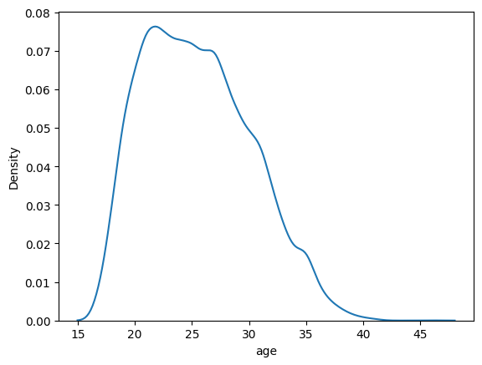
Conduct
Univariate
analysis

Slide 9
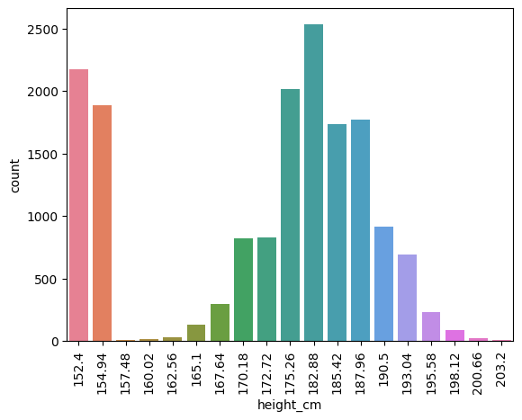
Conduct
Univariate
analysis

Slide 10
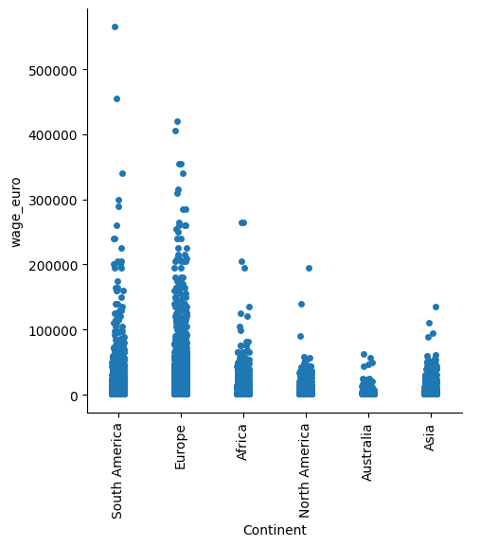
Conduct Bivariate analysis

Slide 11
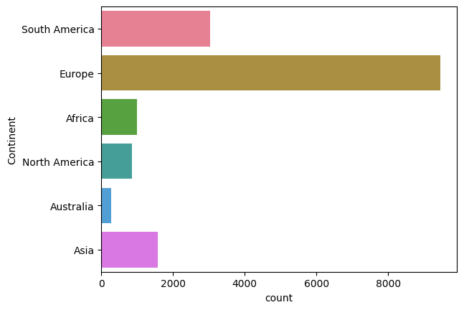
Conduct
Univariate
analysis

Slide 12
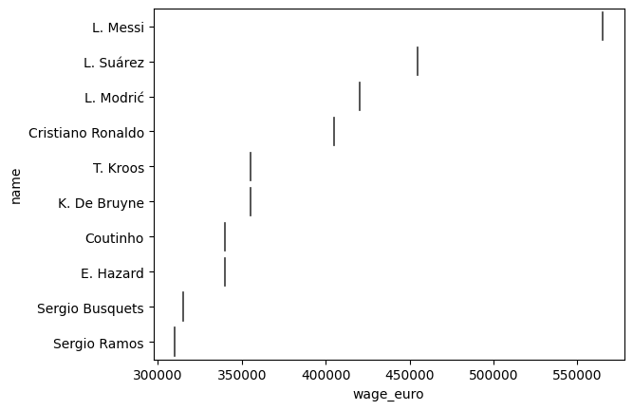
Conduct Bivariate analysis

Slide 13

-Player Profiles: The dataset provides a comprehensive profile of each player,
including their personal details, physical attributes, playing positions, and skill ratings
-Market Value and Wages: The dataset includes information
on the market value and wages of players, which can be used to assess
the financial impact of player contracts and negotiations.
-Preferred Foot and Playing Style: Information on the preferred
foot of players and their skill moves can be used to analyze playing
styles and strategies employed by individual players or teams

Slide 14
THANKS
Any questions?

